Slide 1
Axis Bank Quality Assurance Program week-5 and 6 journey learnings
Shubhadip Paul
Axis QA trainee
Date : 04-NOV-2024

Slide 2

About Me
"Ensuring quality in my work, exploring the heights in my life, and embracing every challenge along the way."

Slide 3

My learnings from this week!

Slide 4

Learning 1 | Automation Testing….
Automation Testing is a software testing technique that uses automated tools and scripts to perform tests. Instead of manually executing test cases, automation tests help in repeating test scenarios frequently and at a larger scale with greater accuracy.
Faster Execution: Automated tests can be run much faster than manual tests.
Reusability: Once written, test scripts can be reused multiple times.
Reliability: It eliminates human error in test execution.
Cost-effective: In the long run, automating tests reduces costs, especially for regression testing.
Continuous Integration: Automation supports continuous testing during development cycles.

Slide 5

Learning 1 | Introduction to Selenium
Selenium is a popular tool for automating web browser tasks, often used in software testing (QA).
It allows testers to simulate user interactions like clicking buttons, entering text, or navigating between pages. Selenium supports multiple programming languages (Java etc.) and works with various browsers like Chrome, Firefox, and Safari.
It’s widely used for functional testing to verify that web applications behave as expected. Selenium WebDriver, a key component, controls the browser at a high level.
It’s open-source, making it cost-effective and highly customizable for different testing needs.

Slide 6
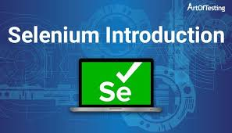
Learning 1 | Introduction to Selenium
Selenium is one of the most popular open-source tools for automating web applications. It supports multiple programming languages, including Java, Python and others. Selenium is widely used for automating functional tests for web-based applications.
Cross-browser compatibility: Selenium allows automation on various browsers like Chrome, Firefox, Edge, etc.
Platform Independence: Selenium supports various operating systems, including Windows, macOS, and Linux.
The main components of Selenium are:
Selenium IDE
Selenium WebDriver
Selenium Grid

Slide 7
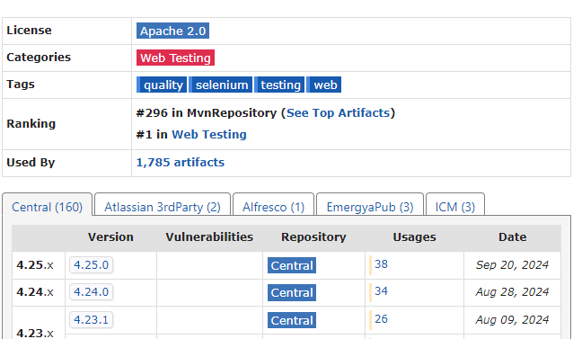
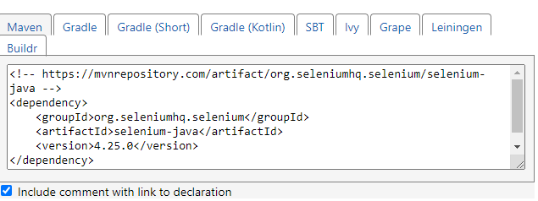
Learning 1 | Installation of Selenium
Installation of Selenium:
Selenium is an open-source project that provides tools and libraries for web browser automation. Here are some ways to install Selenium: Using Eclipse IDE Install JDK 7 or higher,
download Eclipse IDE, download the Selenium Java client driver, install the Internet Explorer Driver Server, and configure Eclipse with the Web Driver.

Slide 8
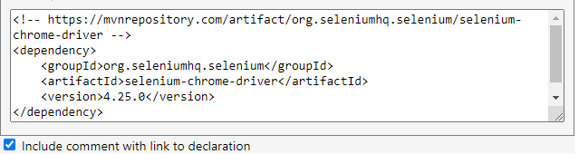
Learning 1 | Introduction of Selenium WebDriver
Introduction of Selenium WebDriver:
Selenium WebDriver is the most powerful and widely used component of the Selenium suite. It provides an interface for writing test scripts that control the browser directly and can perform complex actions.

Slide 9
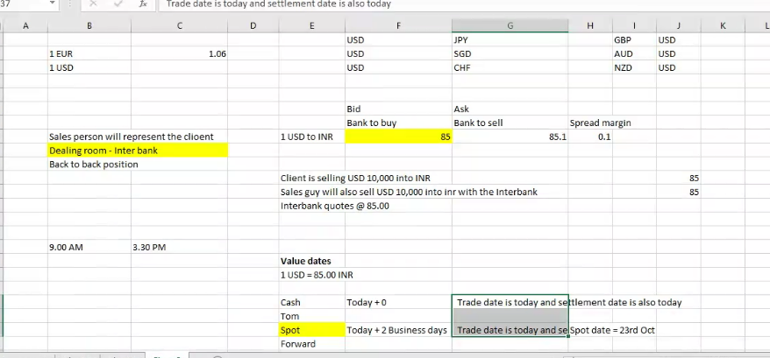
Learning 1 | Axis Bank QA - VHs to introduce their…
The Treasury Department in Axis Bank, under the BSG (Business Services Group) Vertical, plays a critical role in managing the bank’s financial health by overseeing liquidity, investments, and financial risks.
One of the primary responsibilities of the treasury is Liquidity Management, ensuring that the bank has enough cash flow to meet its obligations, such as withdrawals and loan disbursements, while strategically investing surplus funds to generate returns.
The department is also involved in Investment Management, where it oversees the bank’s portfolio of government securities, corporate bonds, and other financial assets to balance risk and return.

Slide 10
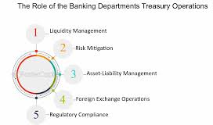
Learning 1 | Treasury Department

Slide 11
Learning 1 | Testing Center of Excellence (TCoE)
The Testing Center of Excellence (TCoE) is a centralized unit in an organization responsible for standardizing and governing all testing activities. It includes:
Automation Testing Team: Focuses on creating and maintaining automated test scripts to improve efficiency and speed.
Functional Testing Team: Manages manual and user acceptance testing to validate functionality against requirements.
Governance Team: Sets testing standards, ensures compliance, and tracks key performance metrics.
Test Automation Architect: Designs reusable test frameworks and strategies for automation.
Test Auditors: Ensure processes follow internal standards and regulatory requirements.
Test Reporting & Metrics: Tracks quality metrics like test coverage and defect rates.
UAT Coordinators: Manage business validation of software.
Compliance & Risk Management: Ensures testing aligns with risk protocols.
Continuous Improvement: Audits and refines testing processes.
Cross-team Collaboration: Links testing with development and operations for streamlined workflows.

Slide 12
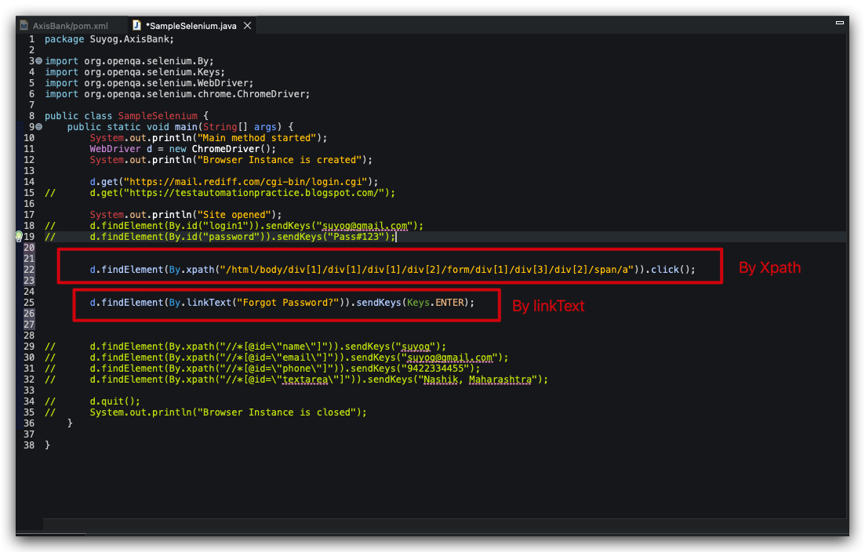
Learning 1 | Selenium performances

Slide 13

Learning day 2
Basics codes of selenium with java

Slide 14

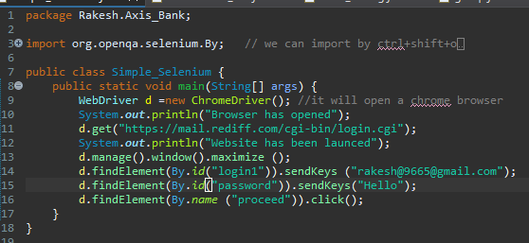
Learning 2 | Basics codes of selenium with java
This Java program automates a web page interaction using **Selenium WebDriver**. It begins by launching the **Chrome browser** using `ChromeDriver` and navigates to a specified URL.
Various **web elements** (input fields, radio buttons, checkboxes) are located using **locators** such as `id` and `xpath`, and actions like entering text (“sendKeys()”) and clicking (`click()`) are performed.

Slide 15
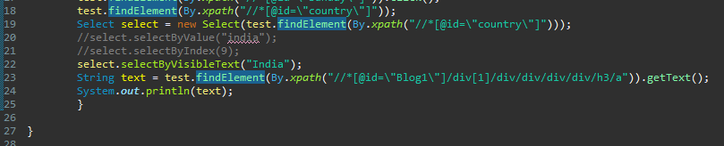
Learning 2 | Basics codes of selenium with java
A **dropdown menu** is handled using the `Select` class, where the option "India" is selected based on visible text. Additionally, text from a specific webpage element is extracted using `getText()` and printed to the console.
**XPath** is used extensively for locating elements in the document structure. This program showcases fundamental web automation techniques, including interacting with forms, handling dropdowns, and validating data via text extraction.

Slide 16

Relevance of learnings for my organization

Slide 17
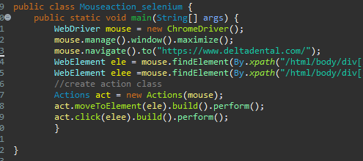
Learning 3 | Basics codes of selenium with java
Automation testing on Mouse action and click on websitesite
The Mouseaction_selenium class contains the main method, which is the entry point of the program.
Inside the main method, an instance of ChromeDriver is created to control the Chrome browser.
The browser window is maximized using mouse.manage().window().maximize().
The program navigates to the Delta Dental website.
Two web elements are located using XPath: one for a menu item (ele) and another for a submenu item (elee).
An Actions class is created to handle mouse interactions.
The ‘moveToElement’ method moves the mouse pointer to the menu item (ele).
The click method is used to click on the submenu item (elee).
The build().perform() ensures that these actions are executed.
This code simulates a user hovering over a menu and clicking a submenu link.

Slide 18
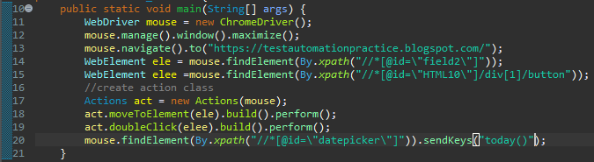
Learning 3 | Basics codes of selenium with java
Automation testing on Mouse action and double click on Websitesite
WebDriver initialization: A Chrome browser instance is started using ChromeDriver().
Maximize the window: The browser window is maximized to full screen for better visibility.
Navigate to URL: The browser is directed to the specified webpage using navigate().to().
Locate elements: The code identifies two elements using their XPath. One is a text field, and the other is a button.
Create Actions class: The Actions class is used to handle advanced interactions like mouse movements and clicks.
Move to element: The mouse pointer is moved to the specified text field.
Perform double-click: A double-click is executed on the identified button.
Send keys: The code sends text input (in this case, "today()") into a date picker field.
Interaction simulation: This script simulates user interactions with the webpage, such as clicking and entering text.
Test automation: The code is used to automate testing of UI elements and verify their behavior.

Slide 19

Learning 3 | Axis Bank QA - VHs to introduce their…
About payments and cards
➔ In Axis Bank, the "cards and payments" system is a key part of their services. This includes things like credit, debit, and prepaid cards, which people use to make purchases both online and in stores. Payments are made through various channels such as mobile apps, internet banking, ATMs, and in person at branches. Customers include everyday people, businesses, and government organizations, each with different needs for making fast and safe payments.
➔ UPI (Unified Payments Interface) has made payments much easier, allowing people to transfer money instantly through mobile phones. This is important not only for individual payments but also for bulk payments. Bulk payments are often used by companies or governments to send large amounts of money, like paying salaries or distributing subsidies. To ensure everything works smoothly, it’s important to create test cases that follow the entire process—from when the sender starts the payment to when the receiver gets it.

Slide 20


Learning 3 | Axis Bank QA - VHs to introduce their…
About Cash management
➔ Axis Bank’s Cash Management Services (CMS) help businesses and government organizations manage their money better. For the government, CMS helps collect taxes, pay bills, and distribute funds quickly. For businesses, CMS makes handling payments and collections easier, improving cash flow.
➔ In the capital markets, Axis Bank provides services for businesses to raise money, invest, and trade. This includes things like issuing bonds and managing large financial deals, all done securely to reduce risks.
➔ Corporate Channels allow businesses to manage their finances online. These channels help with tasks like making bulk payments, paying employees, and tracking accounts in real-time, making financial management simple and secure.

Slide 21
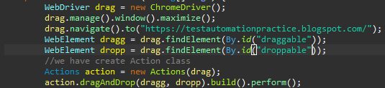
Learning 3 | Basics codes of selenium with java
About Drag and drop method in Automation testing
WebDriver initialization: A Chrome browser instance is launched using ChromeDriver().
Maximize window: The browser window is maximized to ensure full visibility of the page.
Navigate to URL: The browser navigates to the specified URL using navigate().to().
Locate draggable element: The element to be dragged is identified by its id "draggable".
Locate droppable element: The target area where the element will be dropped is found using its id "droppable".
Create Actions class: The Actions class is created to handle advanced interactions, like drag-and-drop.
Drag-and-drop action: The dragAndDrop() method is used to move the draggable element to the droppable target.
Execute action: The build().perform() command finalizes and performs the drag-and-drop interaction.
Simulate user interaction: The code automates the simulation of dragging and dropping an element on the webpage.
Test automation: This is useful for automating tests that check the drag-and-drop functionality in web applications.

Slide 22

Learning 4 | Introduction of Postman Tool for testing
Introduction of Postman tool
Postman is a popular tool used for API (Application Programming Interface) development, testing, and debugging. It’s especially valuable for Quality Assurance (QA) and testing because it enables testers to create, test, and document APIs easily, with features that help validate API behavior, performance, and security. Here’s a quick introduction to Postman for QA and testing:
Key Features of Postman for QA:
API Request Builder: Postman allows you to create and send HTTP requests (GET, POST, PUT, DELETE, etc.) to APIs and receive responses in real time. You can test API endpoints by simulating requests as users would.
Environment Management: It lets you set up multiple environments (e.g., Development, Staging, Production) with specific variables, so you can test APIs in different scenarios without changing code manually.

Slide 23
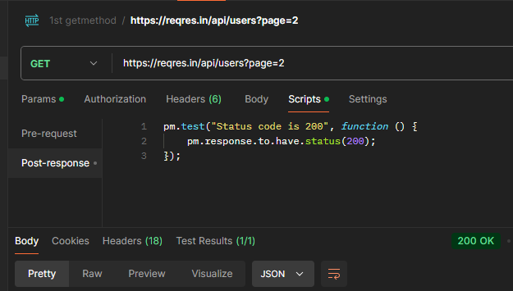
Learning 4 | Introduction of Postman Tool for testing
Introduction of Postman tool
The GET method in Postman is used to retrieve data from a server without altering any server resources. When making a GET request, no data is sent in the request body; instead, any needed parameters are typically added in the URL or as query parameters.
This method is often used to fetch information, such as viewing a user profile, fetching product listings, or retrieving specific records. A successful GET request usually returns a status code of 200 (OK) along with the requested data in JSON, XML, or another format.
Postman allows testers to customize GET requests by adding headers, parameters, and authentication, making it easy to validate that the API returns the expected data for various query scenarios.

Slide 24
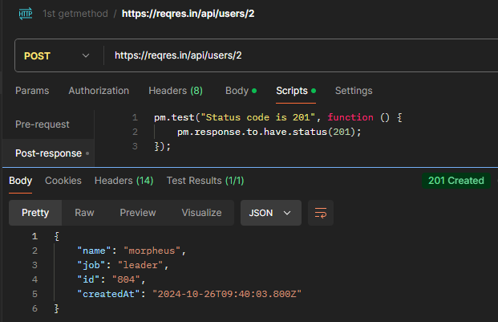
Learning 4 | Introduction of Postman Tool for testing
Introduction of Postman tool
The POST method in Postman is primarily used to send data to a server to create or update resources. When a POST request is made, data is typically included in the body of the request, which might contain JSON, XML, or form data.
This method is commonly used for actions like submitting a form, adding a new entry to a database, or updating existing information. Upon successful execution, a POST request generally returns a status code of 201 (Created) if a new resource was created, or 200 (OK) if data was updated successfully.
In Postman, testers can customize POST requests by adding headers, parameters, and authentication, making it a versatile tool for verifying that the API correctly handles data submission.

Slide 25
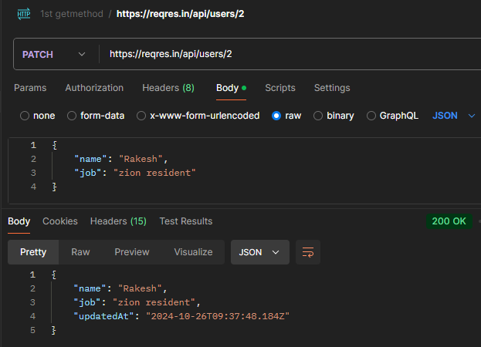
Learning 4 | Introduction of Postman Tool for testing
Introduction of Postman tool
The PATCH method in Postman is used to make partial updates to an existing resource on the server. Unlike the PUT method, which replaces an entire resource, PATCH only modifies the specified fields within a resource, making it efficient for minor updates like changing a user’s email or adjusting a product’s price.
When a PATCH request is sent, data is included in the request body to indicate which fields should be updated, and it typically returns a status code of 200 (OK) if the update is successful or 204 (No Content) if no response body is returned.
In Postman, testers can customize PATCH requests by adding headers, parameters, and authentication, allowing them to validate that the API correctly handles partial updates without overwriting the entire resource.

Slide 26
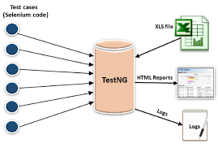
Learning 5 | Introduction of TestNG
Introduction for TestNG
TestNG (Test Next Generation) is a popular testing framework for Java, designed to make test automation more flexible and powerful. It draws inspiration from JUnit and NUnit but introduces additional features that enhance testing for both unit and functional testing. TestNG is widely used in quality assurance (QA) because of its ability to simplify test case organization and execution, making it highly effective for automated testing.

Slide 27
Learning 5 | Introduction of TestNG
Introduction for TestNG
@Test: This is the core annotation in TestNG, used to mark a method as a test case. It allows you to set specific test properties like priority, enabled, and groups. Each method annotated with @Test is treated as an independent test case, which TestNG will run when you execute the test class.
@BeforeMethod: Methods annotated with @BeforeMethod are executed before each @Test method within the same class. This is typically used to set up any preconditions required for the tests, such as initializing data, setting up mock environments, or establishing database connections. This ensures each test case starts with a fresh state.
@AfterMethod: Complementing @BeforeMethod, the @AfterMethod annotation specifies that a method should run after each @Test method. It’s commonly used for cleanup activities, like closing resources, resetting data, or clearing mock states. This helps avoid test contamination and ensures that each test is isolated.
In TestNG, the priority attribute is used within the @Test annotation to define the order in which test methods should be executed. By default, TestNG runs test methods in an unpredictable order, which can sometimes lead to issues, especially if certain tests depend on the results or setup of others. Setting the priority allows you to explicitly control the sequence of test executions.
The priority is an integer value, where a lower number has a higher priority and will execute before higher numbers. For example, a test with priority=1 will run before a test with priority=2. Tests without a specified priority will run after all tests that have a priority assigned. If multiple tests share the same priority, TestNG will execute them in an unspecified order among themselves.

Slide 28
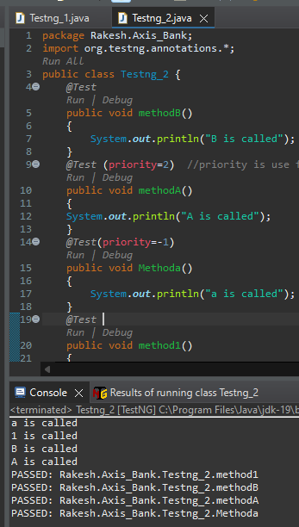
Learning 5 | Introduction of TestNG
Introduction for TestNG of priority
→ In TestNG, methods annotated with @Test are test methods that can be executed independently or together as part of a suite. When we run the Testng_2 class, TestNG will execute each method with @Test in a particular order based on their names (case-sensitive, alphabetical order). Here’s a breakdown of how it works:
Expected Execution Order :- TestNG will execute the test methods in the following order based on the assigned priorities:
Methoda (priority -1)
methodB (default priority 0)
method1 (default priority 0)
methodA (priority 2)

Slide 29

Action Plan

Slide 30
Learning 6 | Introduction of TestNG
Introduction for TestNG on applications
TestNG is a powerful testing framework for Java applications, designed to simplify and enhance the process of writing and running tests.
It supports various types of testing, including unit, integration, and functional tests, making it a popular choice in automation, especially when paired with Selenium WebDriver.
TestNG’s use of annotations, such as @Test, @BeforeMethod, and @AfterMethod, allows developers to define test methods and configurations in an organized way. It also provides advanced features like data-driven testing through @DataProvider, dependency testing, and parallel execution to optimize test performance.
With TestNG, testers can create comprehensive test suites and manage test execution using an XML configuration file (testng.xml). This framework generates detailed reports that help in analyzing test results efficiently, highlighting any failures and passed tests.
Its flexibility and robust features make TestNG a valuable tool for testing applications, ensuring code reliability and streamlining the testing lifecycle.

Slide 31

Learning 7 | About Capstone Projects
Introduction for Capstone projects
Our capstone project is an exciting opportunity to apply our learning in a practical context, and we have carefully selected a team to tackle it. Our group, comprised of motivated and skilled members, has chosen to work on a set of five challenging projects provided by our instructor.
These include writing and executing test cases for the IRCTC application, performing automation testing on various applications, conducting thorough database testing, and developing a comprehensive test plan for the Axis Bank login page application.
Each team member has been assigned specific tasks based on their strengths and expertise to ensure effective collaboration and optimal workflow.
By dividing the workload strategically, we aim to cover all aspects of these projects, from test case documentation and script writing to execution and result analysis, thereby enhancing our skills in automation and database testing.

Slide 32
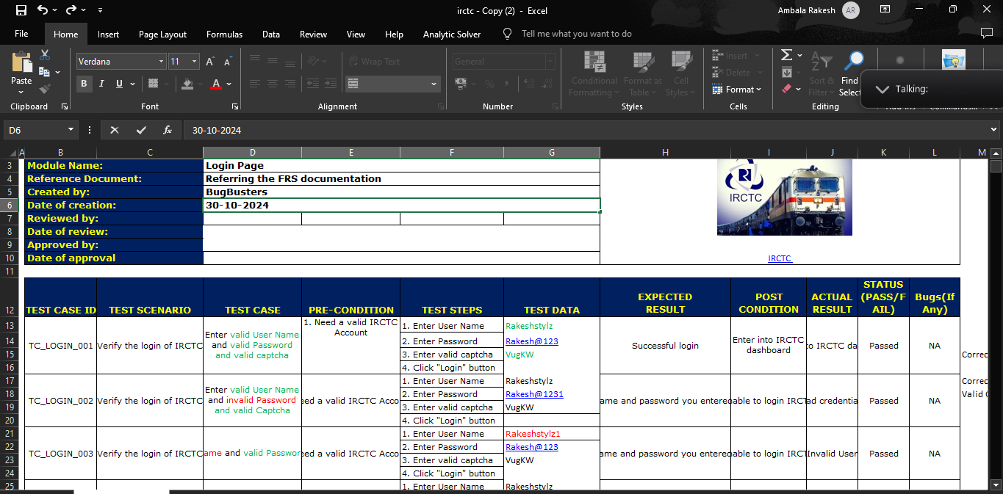
Learning 8 | About Capstone Projects
Introduction for Capstone projects
Today, our team focused on one of our capstone projects involving the IRCTC login page. We collaborated closely to test high-level scenarios, ensuring that each member had a clear understanding of their part and the overall workflow. This collaborative approach allowed us to share insights, learn from each other, and enhance our testing process.
By discussing each step person-to-person, we strengthened our collective knowledge and refined our strategies for executing test cases effectively. This hands-on experience was invaluable for deepening our understanding of testing complex application functionalities.

Slide 33
My Action Plan for this Week
Actions
Timeline
Status
Actions planned for the new learning or overcoming the challenge:
Maintaining the proper documentation of all the topics covered which would help as a reference.
Practicing the concepts on a regular basis.
To understand the concepts in depth and improving the progress.
The planned timeline to implement the actions:
Dedicated timeslots for practicing the concepts.
Focusing on daily progress.
Practical implementation of the concepts thought.
Status of the same by the end of the week:
Initial practice
Reflected progress
Implementation

Slide 34

Learning is also Fun!

Slide 35

Learning is also Fun!
Details of the group activity:
In our breakout session, we were divided into teams of 10 members, each assigned to identify various test cases on the Axis Internet Banking site. Tasks were then broken down into smaller sections and distributed among team members, where each of us was responsible for exploring different test case implementations. Every team member actively contributed, and we successfully identified a comprehensive set of test cases.
Our trainer later reviewed the work, appreciating the team's efforts in finding unique and diverse test cases. This activity reinforced the significance of teamwork in achieving more productive results. Additionally, it deepened our understanding of the testing concepts, allowing us to grasp them more effectively.

Slide 36

Summary
Quick summary:
Last week training covered key concepts in software development and quality assurance, including Starting with Automation Testing fundamentals, you explored the installation of Selenium and an introduction to Selenium WebDriver, delving into basics of Selenium with Java code for testing web applications, including actions like mouse events and clicks. In the Axis Bank QA processes, emphasis was on their Treasury Department and Testing Center of Excellence (TCoE), highlighting their structured approach to quality. You also touched on payments and cards systems, introducing Postman for API testing and covering the basics of TestNG, a testing framework that enhances structured and scalable test automation. These topics together provide a strong foundation in automation testing tools and techniques. TestNG is a robust testing framework for Java that supports various testing types, including unit and integration testing, with features like annotations, parallel execution, and data-driven testing.
Next week, Next week we are focusing of on more CAPSTONE (Introduction, Briefing, Initiation)
One by one projects and presentation on projects ………..

Slide 37
Thank You

